Slide 1
Contents
Cpu burst and I/O burst
Cpu scheduling
Pre emptive and non pre emptive scheduling
First come first serve scheduling algorithm
Shortest job first scheduling algorithm
Shortest remaining time first
Priority scheduling
Round robin scheduling
Multi level queue scheduling
Multi level feedback queue scheduling

Slide 2
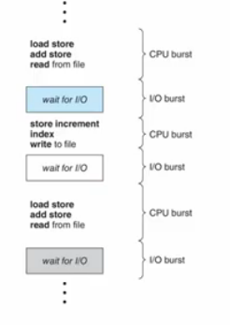
Cpu burst and I/0 burst
Cpu burst: the amount of time when process is being executed in the cpu
I/O burst: the amount of time when the cpu is waiting for the input or output operation to be completed
Burst frequency : duration of cpu burst vary from system to system and process to process
I/O bound program-short cpu burst-games, word processing
cpu bound program- few long cpu burst – scientific and enginerint app
Process scheduling: decision is effected by the nature of the program.

Slide 3
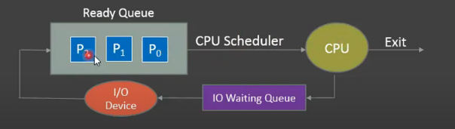
CPU Scheduling
In single processor system only process can run at a time, cpu sits ideal during I/O wait.
How could we increase cpu utilization?
Multi-programming
Cpu scheduler: the part of OS that selects from the ready queue to run process and dispatch it to cpu.
Ready queue: list of all processes in main memory that are ready and waiting for cpu allocation.

Slide 4
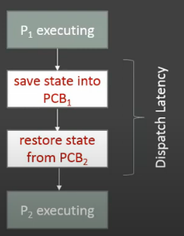
Dispatcher: OS module , gives control of the cpu to the process selected by the cpu scheduler.
Dispatch latency – time it takes for the dispatcher
to stop one process and start another running.
Dispatcher operation involves
Switching context
Switching to user mode
Jumping to the proper location in the user program to restart that program.

Slide 5
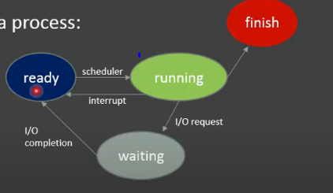
Pre-emptive and non pre-emptive scheduling
Non pre-emptive : when a process switches from running to waiting state or terminates.
Pre-emptive: when state transition occurs from running to ready or from waiting to ready.
Pre emptive scheduling problem?---Results in race condition when data are shared among several processes.
Scheduling criteria: compare and choose algorithms.
Cpu utilization
Throughput
Turn around time
Waiting time
Response time

Slide 6
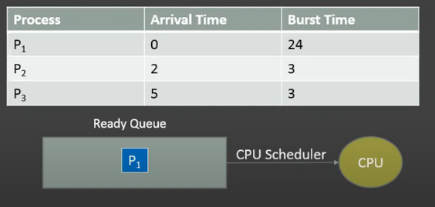
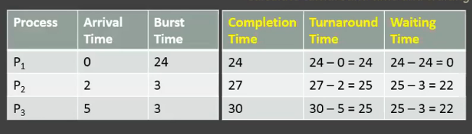
First come first serve scheduling algorithm
FCFS, the process that comes first in the ready queue will be allocated to cpu first.
Example: suppose that three process p1,p2&p3 arrives in the order
Non pre-emptive ,not suitable for multi-tasking systems

Slide 7
First come first serve scheduling algorithm
Strengths : simplest policy
Limitation : average waiting time is often quite long
FCFS is non pre-emptive algorithm
Not suitable for multi- tasking systems

Slide 8
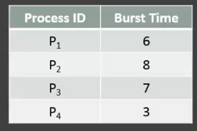
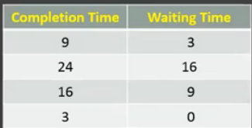

Shortest job first scheduling algorithm
Cpu scheduling policy: pick a process from the ready queue that has shortest burst length.
Two versions: non pre-emptive and pre- emptive.
Average waiting time :
(3+16+9+0)/4=7

Slide 9
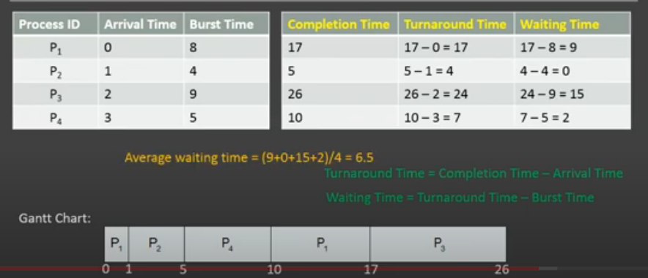
Shortest remaining time first
Pre emptive version of SJF, the scheduling decision is retaken using the sjf algotihm.
Run the process with shortest next burst length.

Slide 10
Strengths : SJF gives minimum average waiting time
SRTF is more optimal than SJF
Limitations :
Can not be implemented for short term scheduling

Slide 11
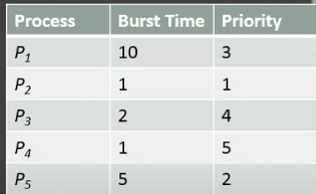

Priority scheduling
Pick a highest priority process from the available processes.
Two versions: pre-emptive and non pre-emptive.
Waiting time for p1-6,p2-0,p3-16,p4-18,p5-1.
Average waiting time =(6+0+16+18+1)/5=8.2

Slide 12
Strengths :
Allows a high priority process to run first
Inverse of predicted next cpu burst time
Limitations :
Starvations: ready to run but waiting for cpu can be blocked
Solution: aging --- increase the priority of the process that wait in the system for long time

Slide 13
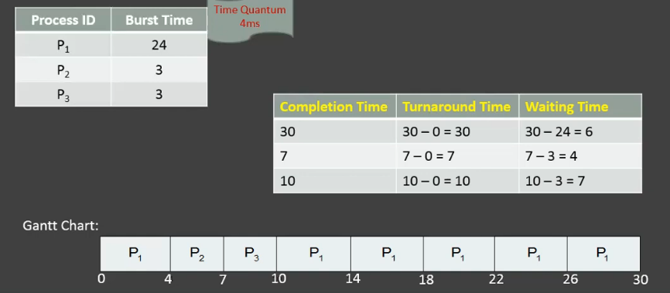
Round robin scheduling
Designed for time sharing systems, after the expiry of time quantum, cpu is switched to next process.
Scheduler picks a process from the head of the queue, sets timer to interrupt after 1 time quantum, and allocates it to cpu.
Two possibilities: running process has burst length <time quantum and executing process has burst length>time quantum

Slide 14
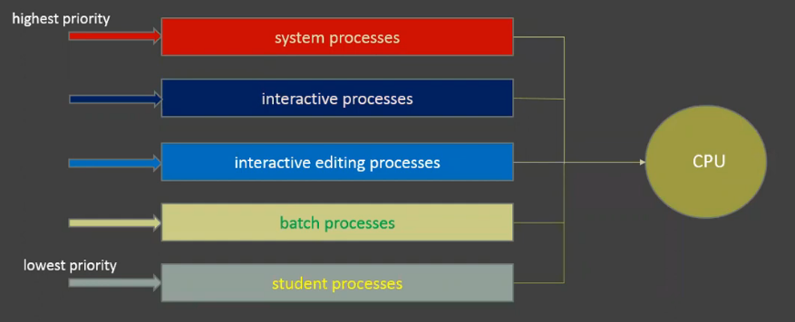
Multi level queue scheduling
Processes are put into different groups, based on some property, process type, process priority and memory size.
Common classification: 1.fore ground(interactive processes)
2.background (batch processes)
Two approaches : 1. fixed priority with pre emptive scheduling 2. time slicing

Slide 15
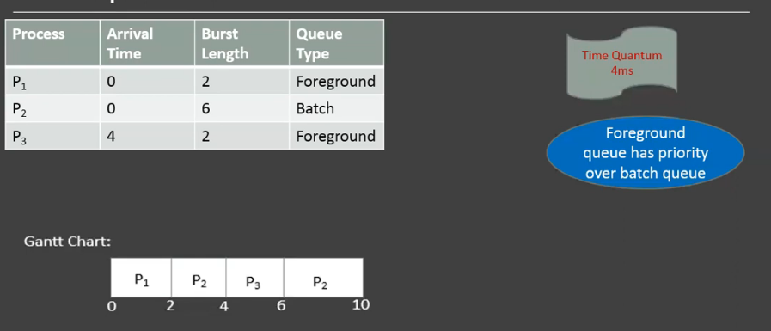

Slide 16
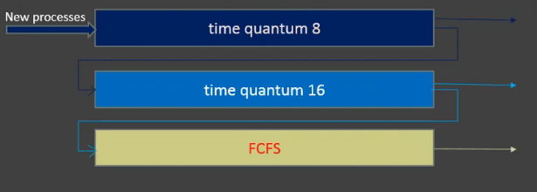
Multi level feedback queue scheduling
A process can move between the queues, uses dynamic priorities, priority can be changed based on its cpu burst time.
A new process is always admitted to a highest priority queue where it is served in RR.
Processes in lower priority queue can not be served until the queues above it have become empty.

Slide 17
Parameters :No of queues
Scheduling algorithm for each queue
The method used to determine when to upgrade a process to a higher priority queue
Demote a process to a lower priority queue
Which queue a process will enter when that process needs service

